Slide 1
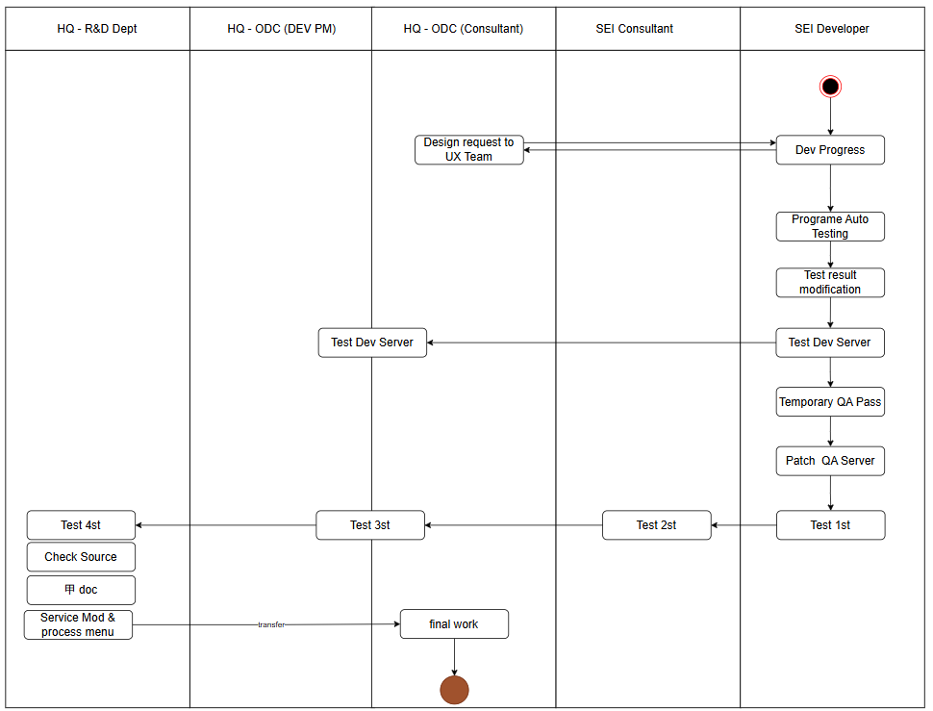

Spec Reg
Delivery
Dev
QA Request
QA Team Test
Role PIC
English
Print Dev

